Slide 1
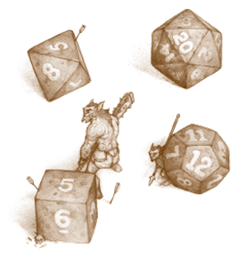
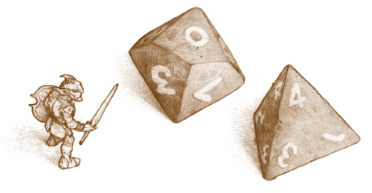
Dungeons and Dragons
Character Creation Workshop
Notes:
FOR THOSE USING THIS POWERPOINT AS A RESOURCE:
Do not reproduce
Do not post online
(There are a lot of copywrite images, and I do not want to get in trouble ☺)
This is not the end all be all. There is much to learn beyond this PowerPoint!
All images of me and of art created by my friends should have been removed before sharing

Slide 2
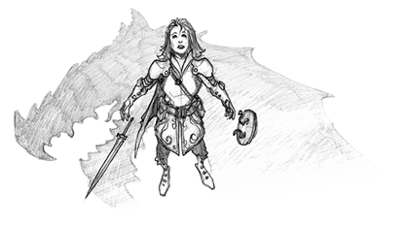
What is D&D?
Some Terms:
Table Top Role Playing Game (TTRPG)
Dungeon Master (DM) / Game Master (GM)
PC vs NPC vs DMPC
Campaign vs One-shot vs Session
“The Party”

Slide 3
Introductions
Name
Preferred Pronouns (she/her/hers; he/him/his; they/them/theirs; etc.)
How much experience you have with DND
Why you are excited to learn to play DND
Notes:
To use in small groups

Slide 4
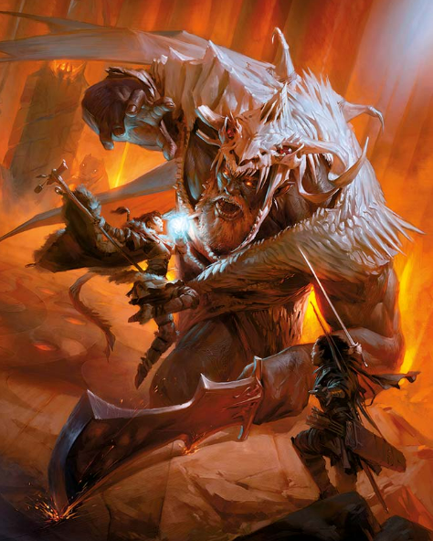
Adventuring Agenda
Classes
Races
Stats
Personality and Backstory
Background
Combat Basics
Abilities
Equipment
Encounter?

Slide 5
DISCLAIMER: WIZARDS OF THE COAST IS NOT RESPONSIBLE FOR THE CONSEQUENCES OF Splitting UP THE PARTY, STICKING APPENDAGEs IN THE MOUTH OF A LEERING GREEN DEVIL FACE, ACCEPTING A DINNER INVITATION FROM BUGBEARS, STORMING THE FEAST HALL OF A HILL GIANT STEADING, ANGERING A DRAGON OF ANY VARIETY, OR SAYING YES WHEN THE DM ASKS, “ARE YOU REALLY SURE?”

Slide 6
Classes

Slide 7
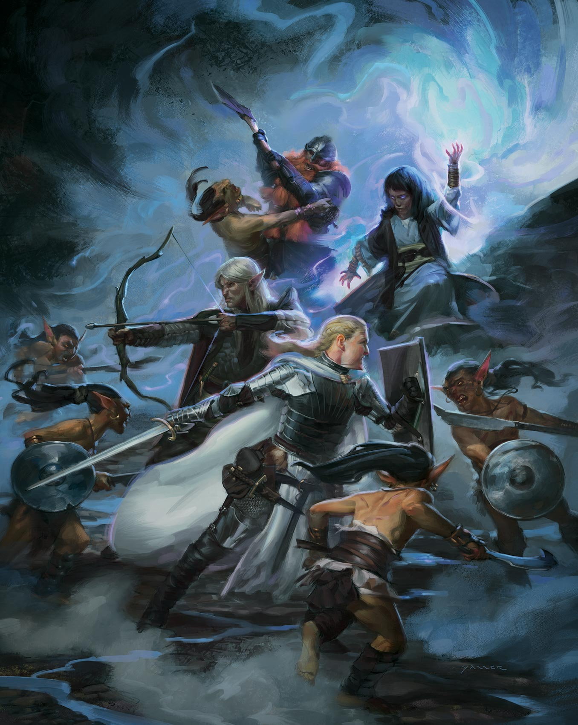
There are 12 Classes
Barbarian
Bard
Cleric
Druid
Fighter
Monk
Paladin
Ranger
Rogue
Sorcerer
Wizard
Warlock
Notes:
“Start thinking about what class you would want your character to be. If you decide you really like multiple, you can always make more characters after this course.”

Slide 8
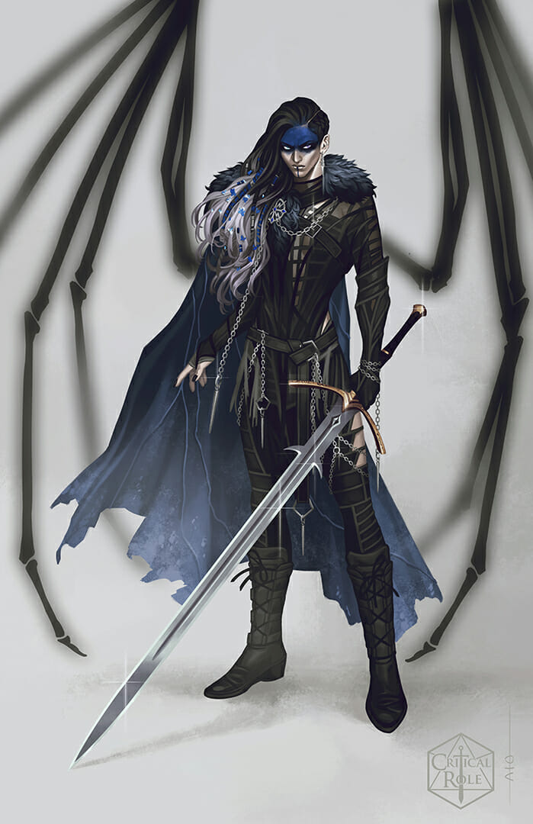
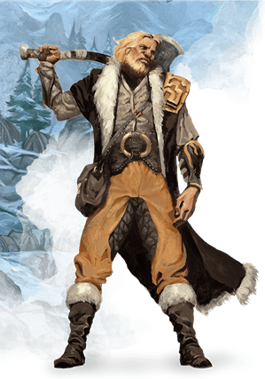
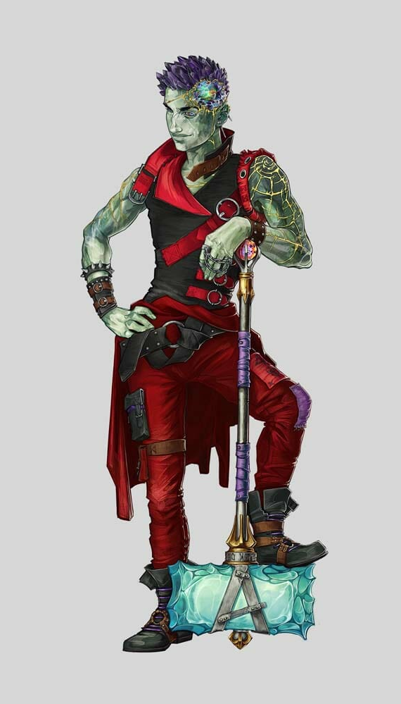
Barbarian
Key Abilities
Heavy Melee Weapons
Most Health of any Class
“I would like… TO RAGE!”
Unarmored Defense

Slide 9
Barbarian

Slide 10
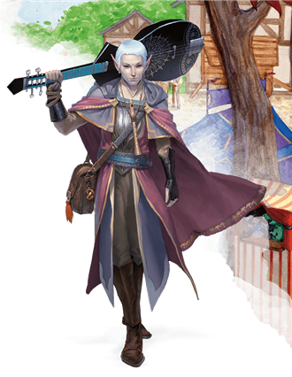
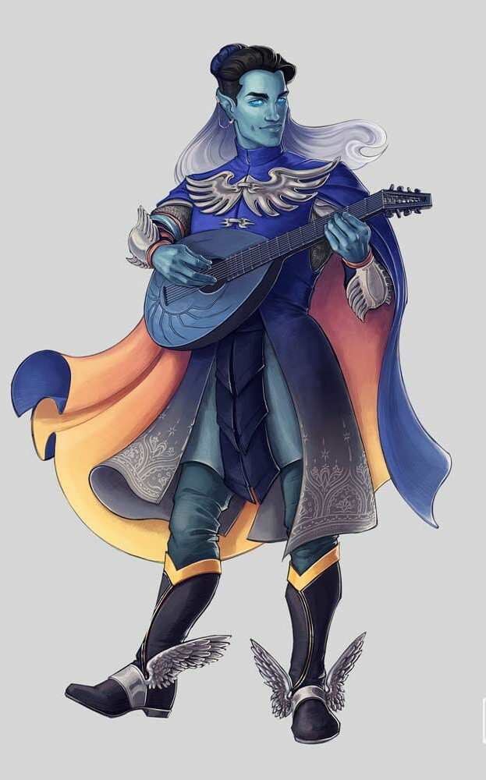
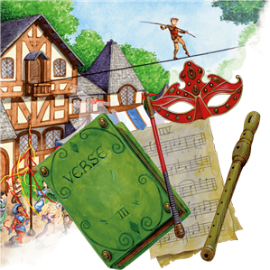
Bard
Key Abilities
Magic through Music
Inspiring
Swordplay
“Jack of all trades”

Slide 11
Bard
Notes:
Skip the first second or two to skip the cuss word.

Slide 12
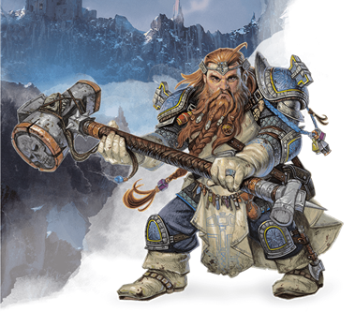
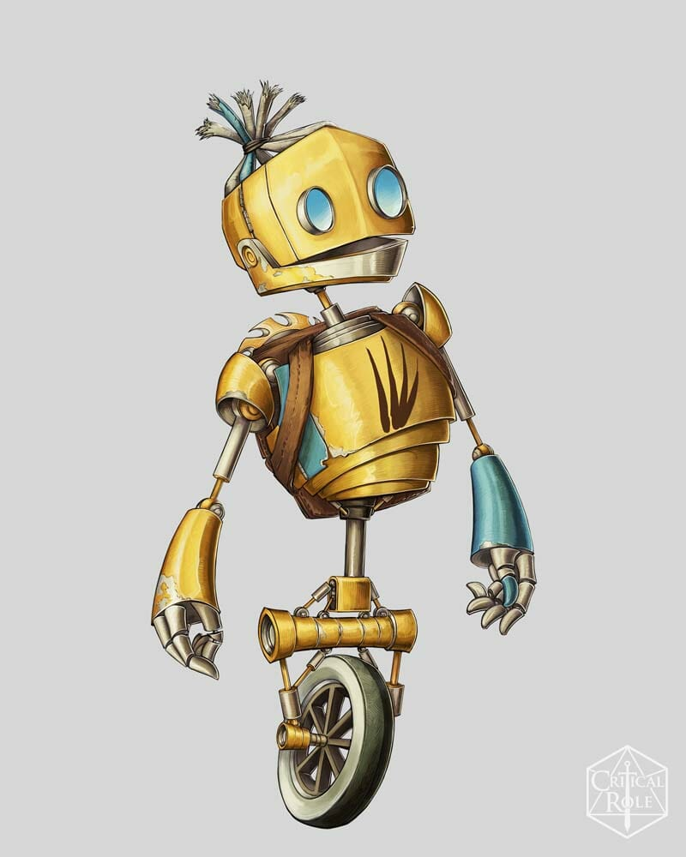
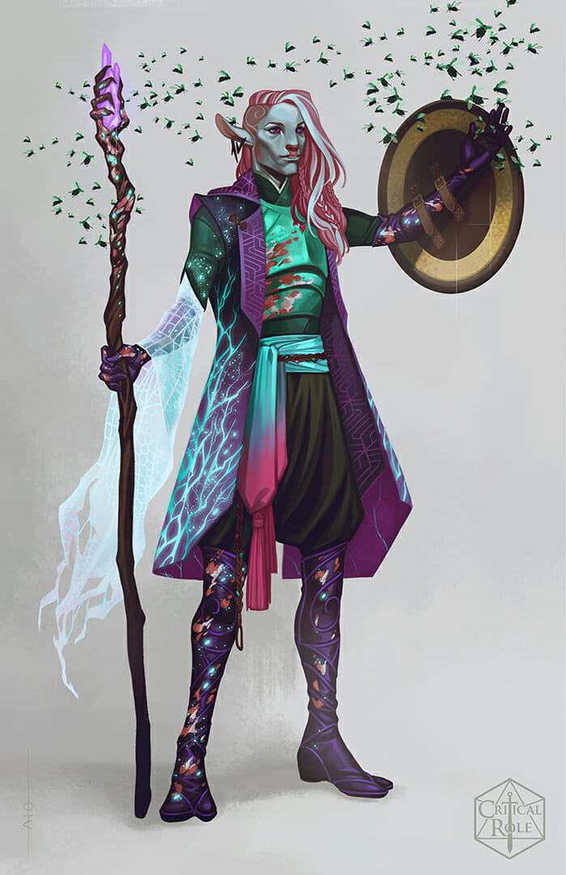
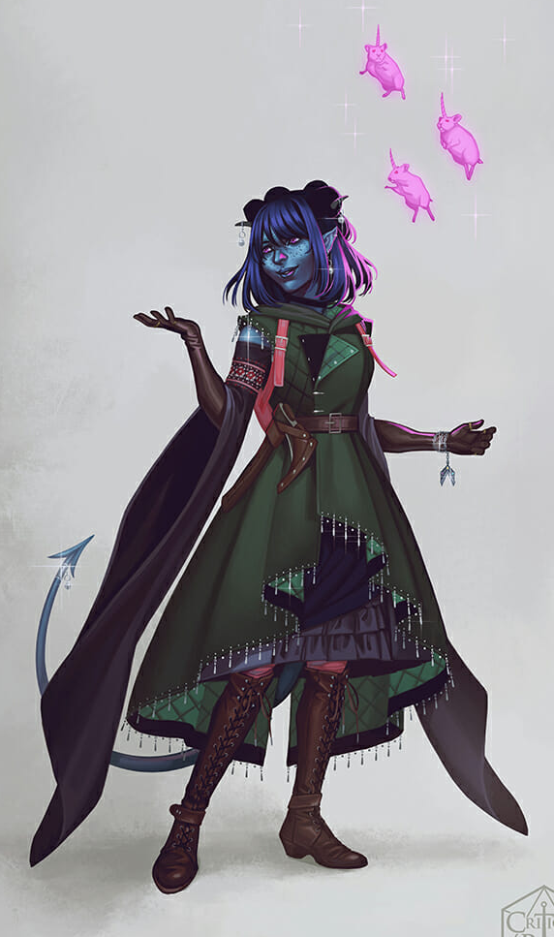
Cleric
Key Abilities
Religious Warriors
Spellcasting + Weapons
Healers (Mostly)
Divine Domains

Slide 13
Cleric
Notes:
Stop at 29 seconds

Slide 14
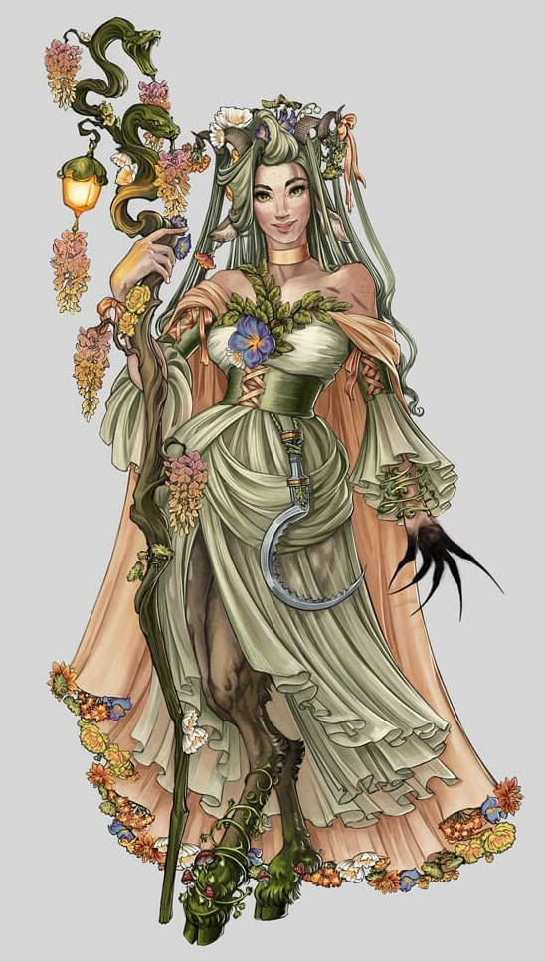
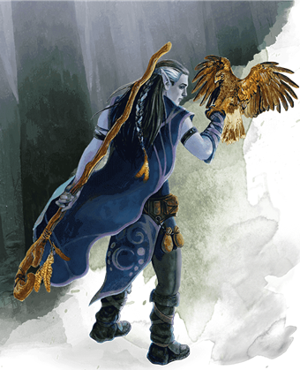
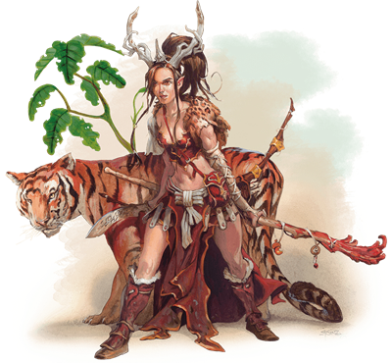
Druid
Key Abilities
Wildshape – Animal Shapeshifters (Level 2)
Staffs and Spellcasting
One with nature

Slide 15
Druid
Notes:
Stop at 1:16

Slide 16
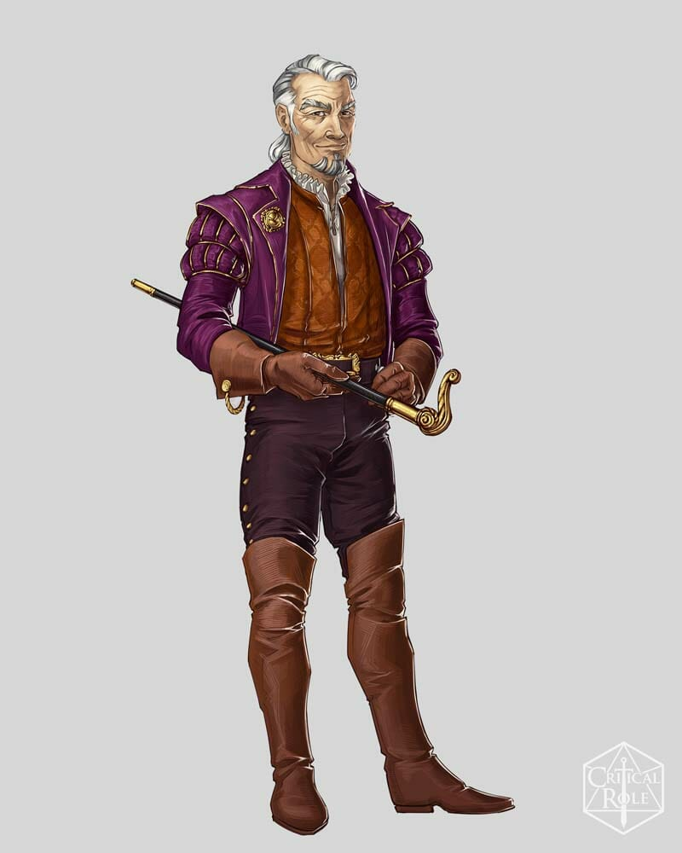
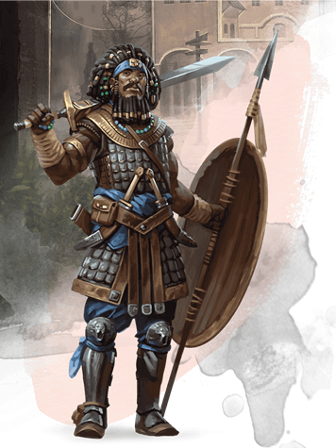
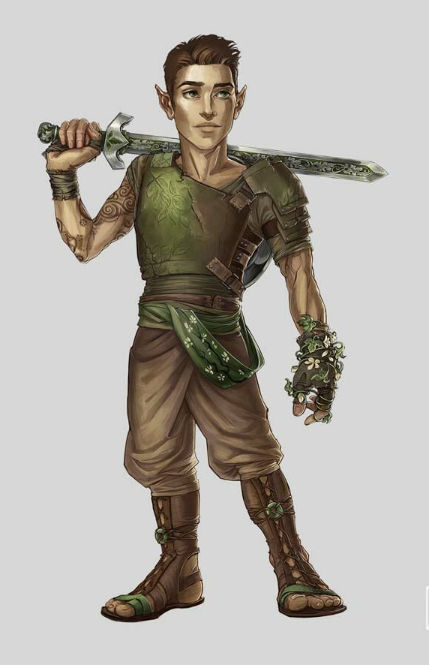
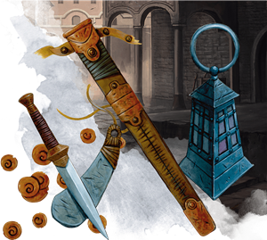
Fighter
Key Abilities
Master of all Weapons and Armor
Fighting Style
“Second Wind”

Slide 17
Fighter

Slide 18
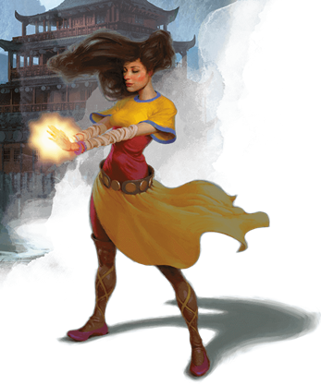
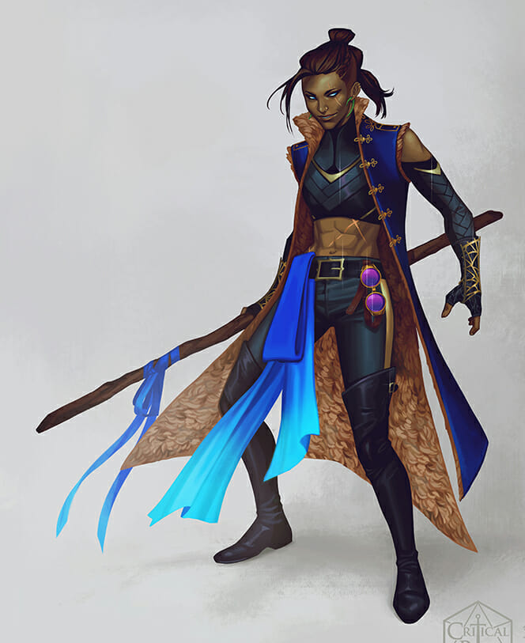
Monk
Key Abilities
Unarmed Strikes and Monk Weapons
Using the Power of Ki (Lvl 2)
Flurry of Blows
Step of the Wind
Unarmored Defense (Lvl 2)

Slide 19
Monk

Slide 20
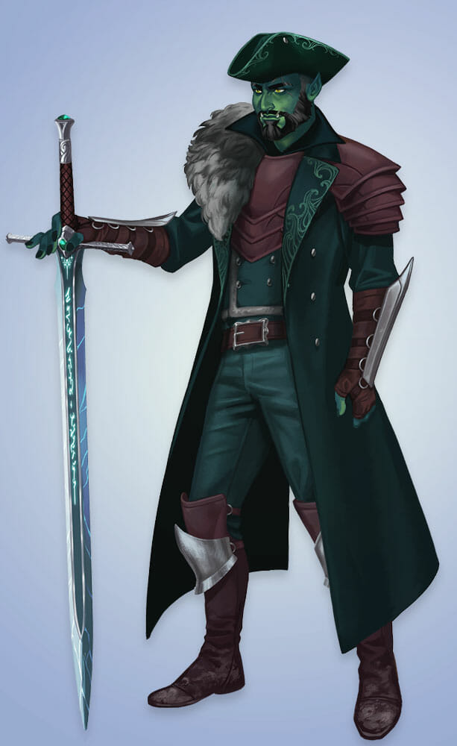
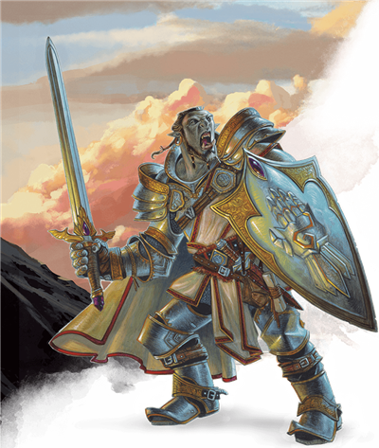
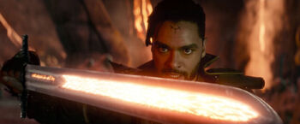
Paladin
Key Abilities
Holy Warriors
All armor
Smite your foes! (Lvl 2)
Minor healing
Detect evil and good forces

Slide 21
Paladin

Slide 22
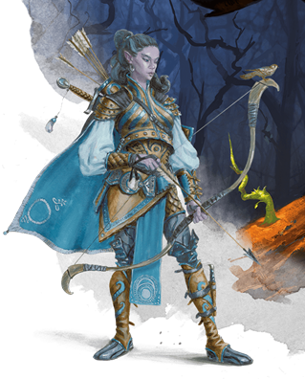
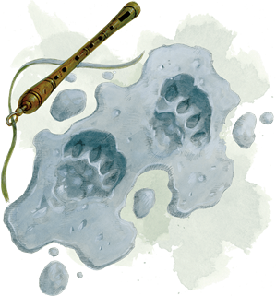
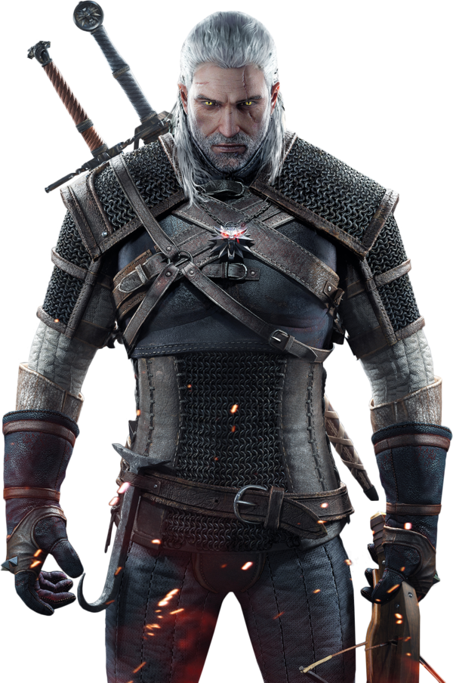
Ranger
Key Abilities
Natures Warriors and Hunters
Half-casters (Lvl 2)
Not always an archer
Expert trackers
Mark a Favored Foe

Slide 23
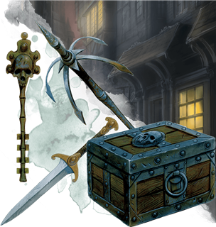
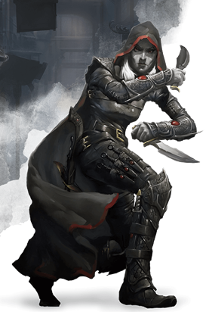
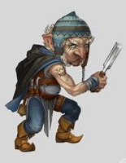
Rogue
Key Abilities
Assassins and Thieves
Sneak Attack
Expertise
Lockpicking Tools and “Thieves’ Cant”

Slide 24
RANGER AND Rogue
Notes:
I did include the right video! It just starts at minute 1:00 for some reason. Start from the beginning and play until 1:00min.

Slide 25
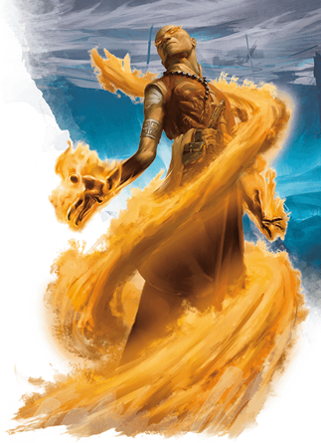
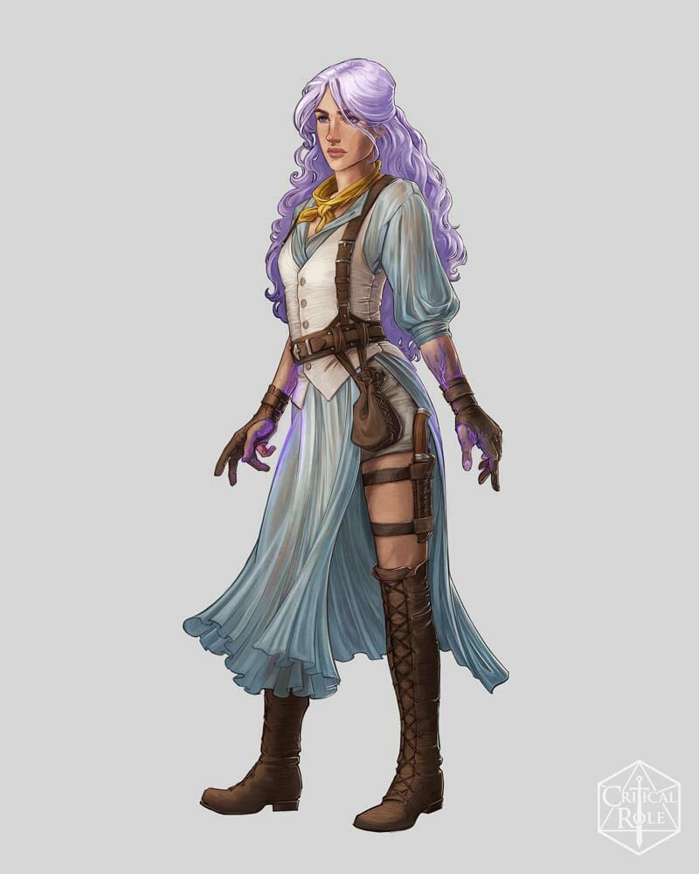
Sorcerer
Key Abilities
Innate or Accidental Magic
Draconic Bloodline
Wild Magic
Uses Will Power to Cast
Tied for Lowest Health

Slide 26
Sorcerer

Slide 27
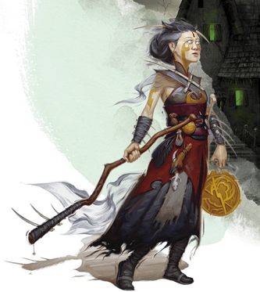
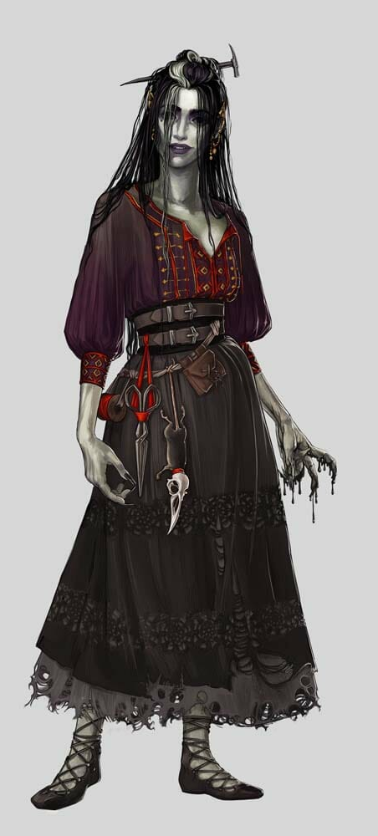
Warlock
Key Abilities
Otherworldly Patron
Archfey
Fiend
Great Old One
Pact Magic
Not Always Evil
Glass Cannon

Slide 28
Warlock

Slide 29
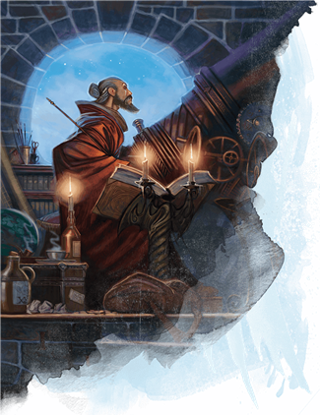
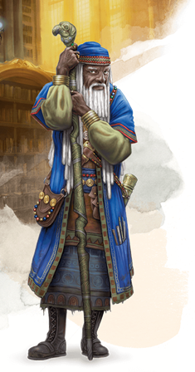
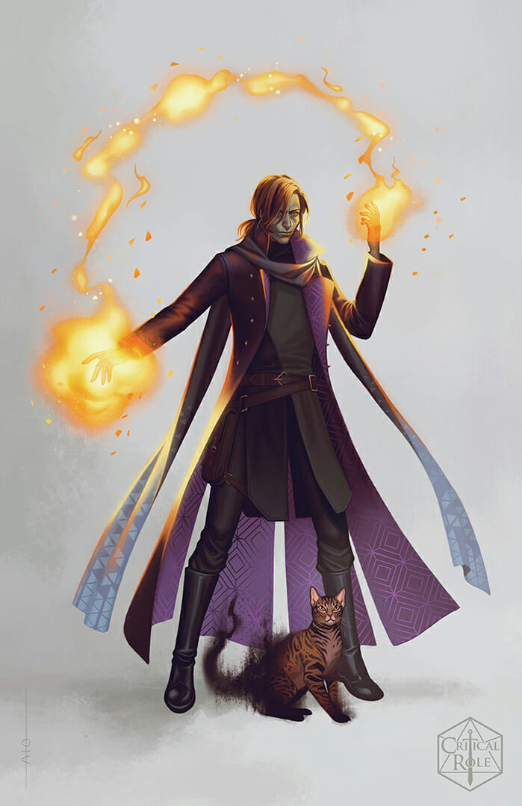
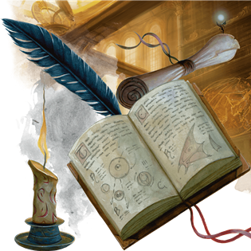
Wizard
Key Abilities
Learned Magic from Books
Access to almost all spells!
Can regain magical energy
Tied for Lowest Health

Slide 30
Wizard

Slide 31
The 12 Classes
Barbarian
Bard
Cleric
Druid
Fighter
Monk
Paladin
Ranger
Rogue
Sorcerer
Wizard
Warlock
Notes:
Say the classes one-by-one and have the students raise their hands based on which class they found the most interesting
Tally on the whiteboard how many students per class
Regroup them based on interest. For instance, if five people want to make a Barbarian character, then have those five students sit together at one table. Multiple similar classes can sit together if the number of students per class is small enough (for instance: 2 Clerics and 3 Paladins can sit together).
Pass out the Character Sheets
Let them know you gave them character sheets and what that means, then ask them to write down their name and class in the spots on the sheet. There’s a lot more to the sheet, and we will go through it piece by piece.

Slide 32
Introductions
Name
Preferred Pronouns (she/her/hers; he/him/his; they/them/theirs; etc.
Grade
Why you are excited to learn to play DND
Notes:
To use in large groups

Slide 33
Races

Slide 34
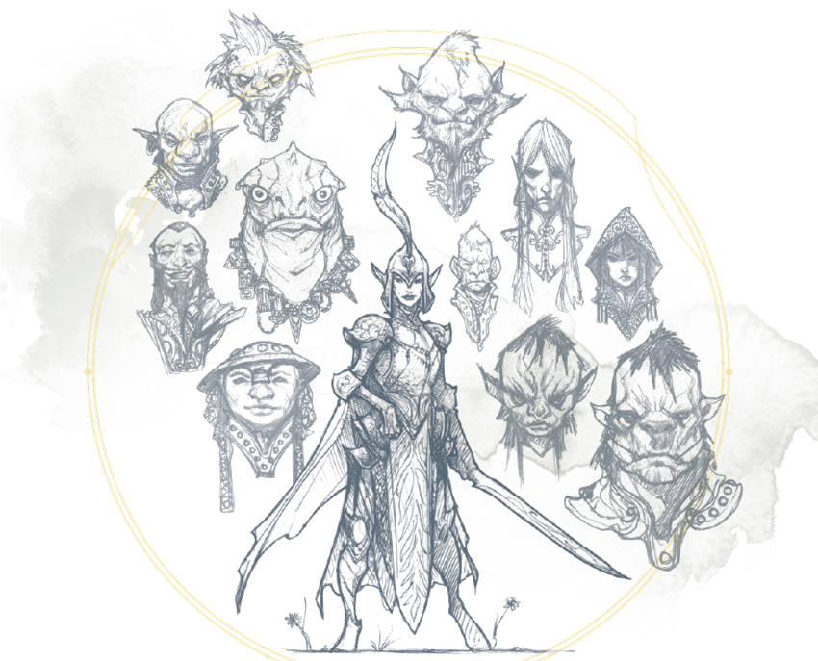
“Race” versus “Species” versus “Ancestry”
“Subrace” versus “Culture” versus “Heritage”
Notes:
The term “races” is controversial in the community. It may be beneficial to draw awareness to this and let the students use the terms “species” or “ancestry” instead. “Subrace” can also be replaced with “culture” or “heritage.” I will be using the terms “race” and “subrace” to be consistent with the source material.
Will also draw attention to how, historically, the source material has associated different races with different moralities. Although we will be using alignment charts for developing our character’s personalities, it is the general consensus in the community that tying a race to a personality is wrong. Dark elves are not born evil, and Dwarves are not born lawful, so we will be ignoring that portion of the rulebook.

Slide 35
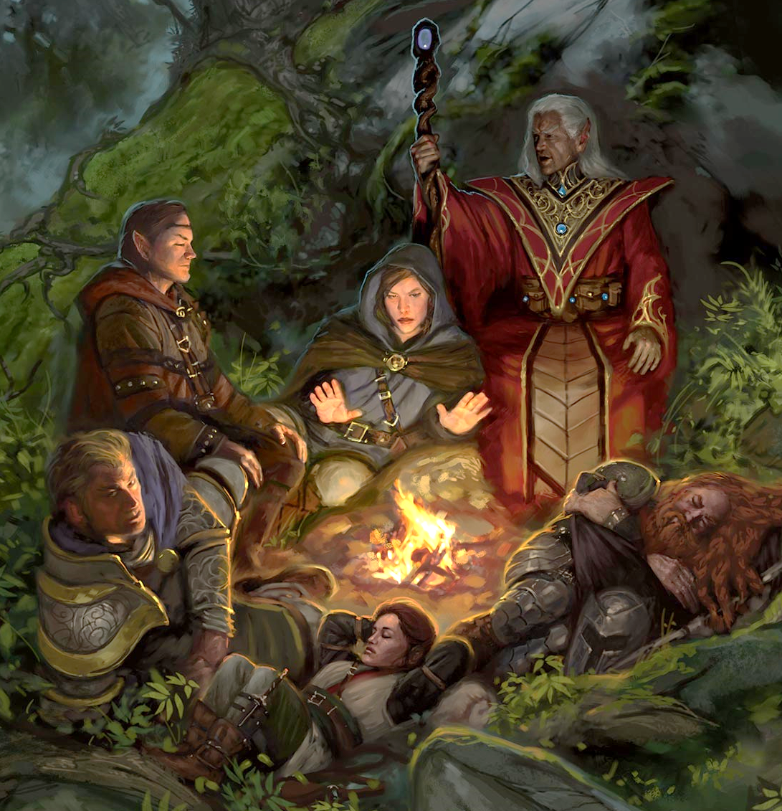
There are 9 Races
Dwarf
Elf
Halfling
Human
Dragonborn
Gnome
Half-elf
Half-orc
Tiefling

Slide 36
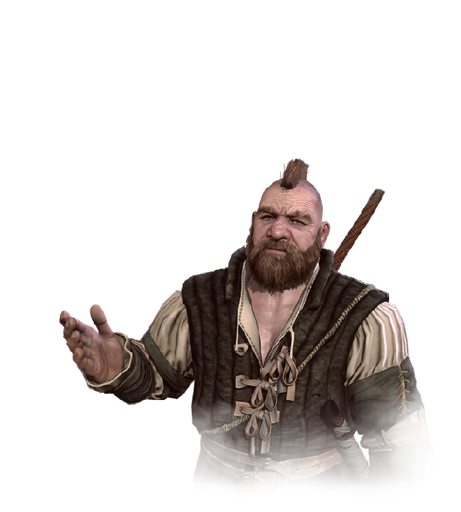
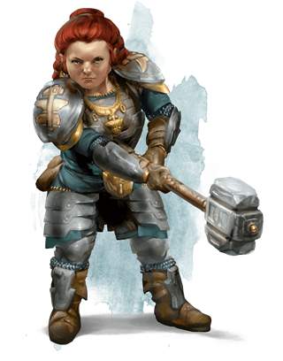
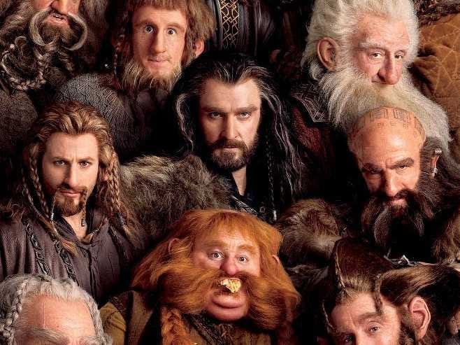
Dwarf
Languages: Common, Dwarvish
Lifespan: 350 years (“young” until 50)
60ft Darkvision
Slower than most races
Resistant to poisons
Natural ability to wield axes and hammers
Smith’s Tools, Brewer’s Supplies, or Mason’s Tools
Appreciative of Stonework
Hill Dwarf
“Gold Dwarves”
Boost to health
Associated with Wisdom
Mountain Dwarf
“Shield Dwarves”
Can use most types of armor
Associated with Strength

Slide 37
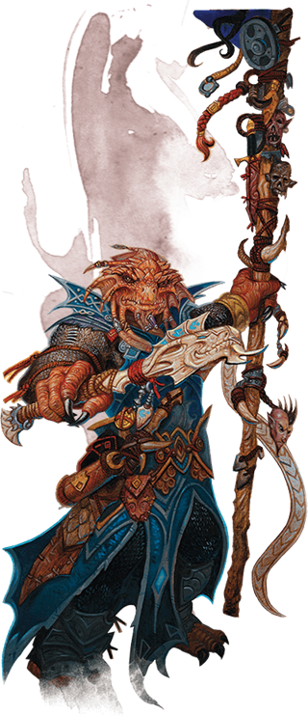
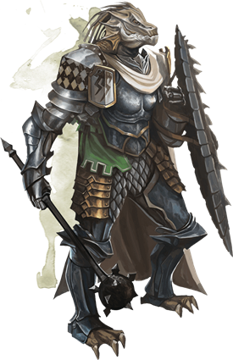
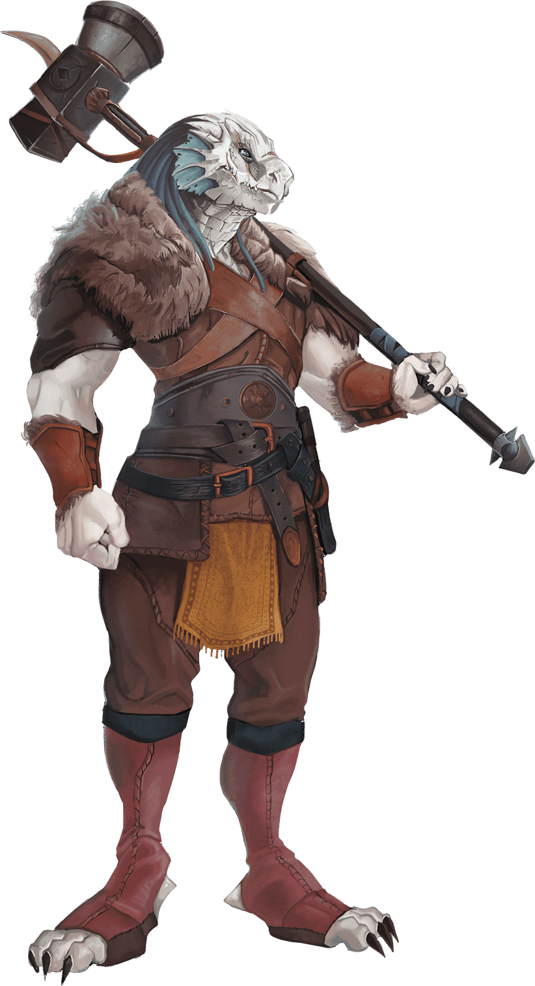
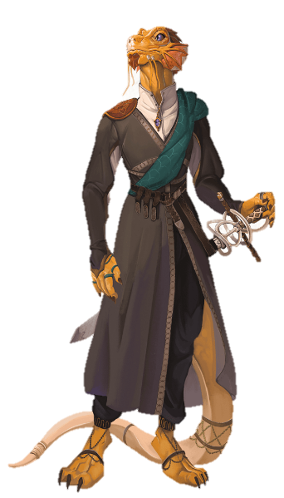
Dragonborn
Languages: Common, Draconic
Lifespan: 80 years (adulthood at 15)
Ancestor of a specific type of dragon
Color
Breath Weapon
Elemental Resistance
No wings “or tail”

Slide 38
Elf
Languages: Common, Elvish
Lifespan: 750 years (claim adulthood at 100)
60ft Darkvision
Keen Senses
Meditate for 4 hours instead of sleeping
Fey Ancestry: “advantage” against being charmed
High Elf
“Sun” and “Moon” Elves
Long/short swords, long/short bows
Extra spell
Extra language of choice
Associated with Knowledge
Wood Elf
“Wild” “Green” “Forest”
Long/short swords, long/short bows
Faster than most
Can hide easily in nature
Associated with Wisdom
Dark Elf (Drow)
Superior Darkvision (120ft)
Sunlight Sensitivity
Natural Magic (3 specific spells)
Rapiers, shortswords, hand crossbows
Associated with Charisma

Slide 39
Gnome
Languages: Common, Gnomish
Lifespan: 350-500 years
60ft Darkvision
Small – Slower than most races
Advantage against some magic attacks
Forest Gnome
Natural Illusionist
Speak with Small Beasts
Associated with Nimbleness
Rock Gnome
Knowledge of Magical Items
Tinker to create specific objects
Associated with Hardiness

Slide 40
Halfling
Languages: Common, Halfling
Lifespan: 150 years
Small – Slower than most races
Lucky – can reroll some rolls
Brave – advantage against being frightened
Can move through the space of a size larger creature
Lightfoot Halfling
Can hide behind a creature one size larger
Associated with Charisma
Stout Halfling
Resistance against poison / Advantage against being poisoned
Associated with Hardiness

Slide 41
human
Languages: Common, one extra of your choice
Lifespan: About a century
Optional: skills, scores, and feats

Slide 42
Half-elf
Languages: Common, Elvish, one extra of your choice
Lifespan: 180 years
60ft Darkvision
Fey Ancestry – advantage against being charmed
Cannot be magically put to sleep
Two additional skills (more on that later)

Slide 43
Half-orc
Languages: Common, Orc
Lifespan: 75 years (adulthood at 14)
60ft Darkvision
Naturally Intimidating
Can keep themselves from dying once
Critical attacks do even more magic

Slide 44
Tiefling
Languages: Common, Infernal
Lifespan: About a century
60ft Darkvision
Resistance to fire damage
Natural magic grants three specific spells

Slide 45
The 9 Races
Dwarf
Elf
Halfling
Human
Dragonborn
Gnome
Half-elf
Half-orc
Tiefling
*Height and weight alternative options
Notes:
Let them choose their race, show them where to write it down, and let them talk amongst their group about their choices. They can also use this time to start writing some character description if they want.

Slide 46
Stats

Slide 47
*Put a mark next to the ones that are important for your character’s class!

Slide 48
measuring physical power
Main Use: Most Melee Combat and “Thrown” weapons
Primary Classes: Barbarian, Cleric, Fighter, and Paladin
Additional Uses: Jumping, carrying, and grappling and shoving enemies
Associated Skills: Athletics

Slide 49
measuring agility
Main Use: Ranged Combat, melee or thrown weapons with the “Finesse” property
Primary Classes: Bard, Fighter, Monk, Ranger, Rogue
Additional Uses: “Initiative,” escaping a grapple, Armor Class (even for unarmored defense)
Associated Skills: Acrobatics, Slight of Hand, Stealth

Slide 50
measuring endurance
Main Use: Health points (HP)
Primary Classes: Barbarian, Sorcerer
Additional Uses: Resistance to poisons, unarmored bonus for Barbarians
Associated Skills: None
Super important for spellcasters – Concentration

Slide 51
measuring knowledge and reasoning
Main Use: Knowledge checks, magical ability
Primary Classes: Wizard, Rogue
Associated Skills: History, Investigation, Nature, Religion

Slide 52
measuring Experience
Main Use: Checks, magical ability, Monk Ki abilities
Primary Classes: Cleric, Druid, Monk, Ranger
Additional Uses: Passive Perception, unarmored bonus for Monks
Associated Skills: Animal Handling, Insight, Medicine, Perception, Survival

Slide 53
measuring force of personality
Main Use: Checks, magical ability
Primary Classes: Bard, Paladin, Sorcerer, Warlock
Associated Skills: Deception, Intimidation, Performance Persuasion

Slide 54
It’s time… to ROLL!

Slide 55
The Types of Dice
Two of these (percentile die)

Slide 56
To roll stats:
Roll 4d6 -> Reroll 1s -> Reroll the lowest
-> Add the top three -> Write it down and Repeat 6x
14 12 13
8 15 10
= 14
Virtual Dice courtesy of DND Dice Roller - D20 Roller (d20collective.com)

Slide 57
Scores and Modifiers
14
Str Score
20 +5
19-18 +4
17-16 +3
15-14 +2
13-12 +1
11-10 0
9-8 -1
7-6 -2
+2
Strength Modifier
*Think about the benefits/ disadvantages of an odd numbered score
Or Mod =
score -10 / 2
Notes:
But what do these numbers tell us? Modifiers
Example of Barbarian fighting and adding Str mod
For every two score points, the modifier goes up by one
The average civilian has a score of 10 in everything
Benefits? There are ways to increase stats. Less time to get to the next level, when even numbers need two score points (also, you win ties, like in Initiative)
Disadv? So close yet so far from the next mod up

Slide 58
Next Steps
“Racial Bonuses”
+2 points to any one score
+1 point to any additional score
Adjust modifiers accordingly
“Roll” for Health
d12 = Barbarian
d10 = Fighter, Paladin, Ranger
d8 = Bard, Cleric, Druid, Monk, Rogue, Warlock
d6 = Sorcerer, Wizard
+Constitution Modifier
Notes:
No rolling cause only first level

Slide 59
Personality and Backstory

Slide 60
Alignment Chart
Lawful Good Neutral Good
Lawful Neutral True Neutral
Lawful Evil Neutral Evil
Chaotic Good
Chaotic Neutral
Chaotic Evil
Notes:
Note that the alignment chart is a flawed system; can the complexity of a character really be defined within the bounds of nine boxes?

Slide 61
A Storm of Brains
What is your character’s main motivation? (Money, helping others, thrill seeking, etc.)
Does your character like to work with a team or work alone? When working with a team, what role do they normally take?
Who/what does your character go to in difficult times?
Keep in mind, your character is level 1, which means that their story is just beginning. This is your character’s first adventure.

Slide 62
Background

Slide 63
There are 13 Backgrounds
Acolyte
Charlatan
Criminal
Entertainer
Folk Hero
Guild Artisan
Hermit
Noble
Outlander
Sage
Sailor
Soldier
Urchin

Slide 64
Acolyte
Skill Proficiencies: Insight, Religion
Languages: Two of your choice
Equipment: Holy symbol (gift you received when you entered priesthood), a prayer book or wheel, 5 sticks of incense, vestments, a set of common clothes, a pouch containing 15 gold pieces (GP)
Feature: Shelter of the Faithful – provided shelter and healing at holy temples

Slide 65
Acolyte

Slide 66
Charlatan
Skill Proficiencies: Deception, Sleight of Hand
Tool Proficiencies: Disguise kit, forgery kit
Equipment: Set of fine clothes, disguise kit, tools of the con of your choice (ten stoppered bottles filled with colored liquid, a set of weighted dice, a deck of marked cards, or a signet ring of an imaginary duke), and a pouch containing 15 gp
Feature: False Identity – you have documentation, established acquaintances, and disguises that allow you to assume an established persona

Slide 67
Criminal (variant – Spy)
Skill Proficiencies: Deception, Stealth
Tool Proficiencies: One type of gaming set, thieves’ tools
Equipment: Crowbar, set of dark common clothes including a hood, and a pouch containing 15 gp
Feature: Criminal Contact – you know who to talk to in order to connect to the criminal underground wherever you are

Slide 68
Entertainer (variant – Gladiator)
Skill Proficiencies: Acrobatics, Performance
Tool Proficiencies: Disguise kit, one type of musical instrument
Equipment: One musical instrument of your choice, the favor of an admirer (love letter, lock of hair, or trinket), a costume, and a pouch containing 15 gp
Feature: By Popular Demand – can always find a place to perform and receive free food and lodging for the duration; strangers who recognize you from your performances like you

Slide 69
Folk Hero
Skill Proficiencies: Animal Handling, Survival
Tool Proficiencies: One type of artisan’s tools, vehicles (land)
Equipment: One set of artisan’s tools of your choice, a shovel, an iron pot, a set of common clothes, and a pouch containing 10 gp
Feature: Rustic Hospitality – can find places to hide, rest, and recuperate among commoners, as long as doing so does not risk their lives

Slide 70
Guild Artisan (variant – Guild Merchant)
Skill Proficiencies: Insight, Persuasion
Tool Proficiencies: One type of artisan’s tools
Languages: One of your choice
Equipment: One set of artisan’s tools of your choice, a letter of introduction from your guild, a set of traveler’s clothes, and a pouch containing 15 gp
Feature: Guild Member – as long as you pay 5 gold monthly dues, you are provided food and shelter at associated guild halls; the guild will defend you if you are accused of a crime, and you can gain access to political figures

Slide 71
Hermit
Skill Proficiencies: Medicine, Religion
Tool Proficiencies: Herbalism kit
Languages: One of your choice
Equipment: A scroll case stuffed full of notes from your studies or prayers, a winter blanket, a set of common clothes, an herbalism kit, and 5 gp
Feature: Discovery – in your seclusion, you discovered something that is the reason you have left isolation (truth about the cosmos, ancient relic, proof you are innocent, etc.)

Slide 72
Noble (variant – knight)
Skill Proficiencies: History, Persuasion
Tool Proficiencies: One type of gaming set
Languages: One of your choice
Equipment: A set of fine clothes, a signet ring, a scroll of pedigree, and a purse containing 25 gp
Feature: Position of Privilege – you are welcomed by high society and people assume you have the right to be wherever you are
Variant Feature: Retainers – you gain a noble and three commoners who follow you and are under your command. The noble is a Squire, a knight-to-be who will do task for you in exchange for training. The other two commoners can be servants that do such things as care for your horse or help you “don” and “doff” your armor. These retainers will not fight for you, will not follow you into danger, and will leave if they are mistreated.

Slide 73
Outlander
Skill Proficiencies: Athletics, Survival
Tool Proficiencies: One type of musical instrument
Languages: One of your choice
Equipment: A staff, a hunting trap, a trophy from an animal you killed, a set of traveler’s clothes, and a pouch containing 10 gp
Feature: Wanderer - you can always recall the general layout of terrain, settlements, and other features; you can always find fresh food and water for you and up to 5 others

Slide 74
SAGE
Skill Proficiencies: Arcana, History
Languages: Two of your choice
Equipment: A bottle of black ink, a quill, a small knife, a letter from a dead colleague posing a question you have not yet been able to answer, a set of common clothes, and a pouch containing 10 gp
Feature: Researcher – any knowledge you do not have, you almost always know where to find it, unless it is so inaccessible that it may take a whole campaign to find

Slide 75
SAILOR (variant – Pirate)
Skill Proficiencies: Athletics, Perception
Tool Proficiencies: Navigator’s tools, vehicles (water)
Equipment: A belaying pin (club), 50 feet of silk rope, a lucky charm (e.g. a rabbit’s foot, any small trinket such as from the “Trinkets table” in chapter 5), a set of common clothes, and a pouch containing 10 gp
Feature: Ship’s Passage – can call in a favor to get passage for you and your companions on a ship
Variant Feature: Bad Reputation – people are afraid of you, and you can commit small crimes (such as refusing to pay for food at a tavern) without people reporting you to the authorities

Slide 76
SOLDIER
Skill Proficiencies: Athletics, Intimidation
Tool Proficiencies: One type of gaming set, vehicles (land)
Equipment: An insignia of rank, a trophy taken from a fallen enemy (a dagger, broken blade, or piece of a banner), a set of bone dice or deck of cards, a set of common clothes, and a pouch containing 10 gp
Feature: Military Rank – you can invoke your rank to influence other soldiers and requisition simple equipment and horses; you can access to military encampments

Slide 77
URCHIN
Skill Proficiencies: Sleight of Hand, Stealth
Tool Proficiencies: Disguise kit, thieves’ tools
Equipment: A small knife, a map of the city you grew up in, a pet mouse, a token to remember your parents by, a set of common clothes, and a pouch containing 10 gp
Feature: City Secrets – can move twice as fast through cities because of shortcuts you find

Slide 78
The 13 Backgrounds
Acolyte
Charlatan
Criminal
Entertainer
Folk Hero
Guild Artisan
Hermit
Noble
Outlander
Sage
Sailor
Soldier
Urchin

Slide 79
Combat Basics

Slide 80
Grid vs ‘Theatre of Mind’
Movement
Action
Attack Action
Spell
Ability Check
Bonus Action
Some Class Abilities
Some Spells
Reaction
Some Spells
Attack of Opportunity
Free Action
Open a Door
Drop a Weapon
Draw a Weapon
5 ft
5 ft
Notes:
Each box is 5ft by 5ft
If my character (this little heart) has 20ft of movement, they can move up to 4 squares in any direction
Even across diagonals, in a zig zag, backwards, or they don’t even have to move their full movement at all
This impacts everything to do with combat. If I am fighting an enemy 1 square away (meaning they’re within 5 ft) that means they are in melee range (swords good, bows bad)
If they are further away then 5ft, then I either have to close the distance and move up to them to use a melee weapon, or I have to use something ranged (like a bow or throwing axe)
DND is all turn based combat; on a single turn, you can do one of each of the following

Slide 81
Equipment

Slide 82
Armor and Armor Class (AC)

Slide 83
Roll to Hit!
Roll Damage!
d20 + Strength modifier + proficiency bonus
Damage dice + Strength modifier
d20 + Dexterity modifier + proficiency bonus
Damage dice + Dexterity modifier

Slide 85
Notes:
Light weapons: can fight with two
Heavy weapons: disadv for small or tiny creat

Slide 88
A Word on Spells

Slide 89
Encounter!

Slide 90
Player Etiquette
Give everyone equal time to act and interact
No hogging the spotlight
No Player vs Player combat
Do nothing in character to another that you wouldn’t want done to you
Do not judge other people’s characters or character choices
Let the DM finish describing a scene before speaking
Try not to interrupt each other

Slide 92
Notes:
Play Music!
Keep track on the white board

Slide 93
THANK YOU FOR PLAYING!!!
Notes:
There is so much more!
Leveling up, other classes, subclasses, races, monsters, adventures!

Slide 94
Helpful Resources:
Free Resources for playing DND (with some premium options)
For more information/options for all things DND (also has a pretty easy-to-use character creator if you make an account): https://www.dndbeyond.com
Fillable/printable character sheet: https://media.wizards.com/2016/dnd/downloads/5E_CharacterSheet_Fillable.pdf
For playing DND online with a Grid: https://app.roll20.net
Extra free and creative resources (with premium options)
For creating large scale and encounter maps: https://inkarnate.com
For creating characters (can also order a “mini” figurine of your character): https://www.heroforge.com
Fun website I use for choosing names: https://www.behindthename.com/
Notes:
There is so much more!
Leveling up, other classes, subclasses, races, monsters, adventures!

